Slide 1
Bleecker Alexander
Serenity
Humor
General Love Friend + Romantic
Intellectualism
Make a Difference
Accomplishment
Organization
Discipline

Slide 2
Lance Bisesar
Validation
Friends & Family
Trust
Success
Pleasure
Balance
Wisdom
Focus
Notes:
** 横向折线箭头出现了问题

Slide 3
Kelly Clark (*)
Toy
Unconditional Love
Success
Grace
Well Being
Gratitude
Adventure
Optimism
Notes:
自下而上，Grace，Well Being，Gratitude => Unconditional Love，Success Manually adjusted

Slide 4
Matthew Durkin
Fulfillment
Significance
Connected
Fairness
Recognition
Family + Friends
Authenticity
Hard Work

Slide 5
Chioma Enechukwu
Pleasure
Love
Connected
Empowerment
Enthusiasm
Affection
Equity
Reward
Self-Awareness

Slide 6
Jeancarlo Guevara
Inner Peace
Family & Friends
Stability
Dreaming
Ethical
Development
Equity
Positivism

Slide 7
Leonardo Henao Melo
Inner Harmony
Family
Growth
Legacy
perseverance
Bravery
Helping Others
Adventure

Slide 8
Marynella Hernandez
Moral Beauty
Inner Harmony
Respect
Improvement
Security
Acknowledgment
Strong Work Ethic
Communication

Slide 9
Zeeshan Jafry
Contentment
Family
Peace
Ethical
Commitment
Flexibility
Empathy
Excellence
Optimism

Slide 10
Di Jing
Wellbeing
Growth
Relationship
Adventure
Empowerment
LOve
Family
Communication

Slide 11
Anshula Johri
Happiness
Love
Wealth
Accomplishment
Heart
Imagination
Curiosity
Determination

Slide 12
Vanessa Lee
Well-Being
Character
Ambition
Stability
Trust
Fortitude
Curiosity
Confidence
Belonging

Slide 13
Yucan Liu
Happiness
Respect
Family
Achievement
Health
Growth
Wealth
Energy

Slide 14
Lily MacGregor
Inner Peace
Family
Success
Gratitude
Growth
Acknowledgment
Fairness
Legacy

Slide 15
Taylor McCoy
Legacy
Goodness
Trust
Inner Peace
Discovery
Courage
Grit
Optimism

Slide 16
Gregory Mo
Authentic
Organization
Relationships
Calm
Compere
Family Security
Family
Humor

Slide 17
Edon Molic
Legacy
Actualization
Family
Moral Courage
Compassion
Discipline
Quality
Resilience

Slide 18
Daniel Moser
Connection
Inner Peace
Friends + Family
Unconditional Love
Self-Growth
Fulfillment
Make a Difference
Significant to Myself

Slide 19
Sylvan Ryder
Thriving
Harmony
Joy
Ambition
Community
Gratitude
Dedication
Compassion

Slide 20
Israel Sierra
Happiness
Family
Excel
Work Life / Balance
Reward
Fulfillment
Recognition
Satisfaction

Slide 21
Elizabeth Sweeney
Contentment
Help People
Family
Valued
Authenticity
Make a Difference
Growth
Empowerment

Slide 22
Tim Kauer
Health
Fun
Character
Kindness
Professionalism
Honor
Freedom
Confidence

Slide 23
Jian Tinker
Significance
Wealth
Innovation
Energy
Satisfaction
Ease
Unconditional Love
Playfulness

Slide 24
Kevin Tran
Education
Balance
Financial Security
Health
Adventure
Heart
Free Expression
Outcomes

Slide 25
Ema Vidak Friedman
INTEGRITY
Fairness
Confidence
Engagement
Dignity
Feeling Valued
Relationship
Make Things Better

Slide 26
Erte Xia
Challenge
Continuance
Creativity
Diligence
Responsibility
Logic
FreeExpertisedom
Initiative

Slide 27
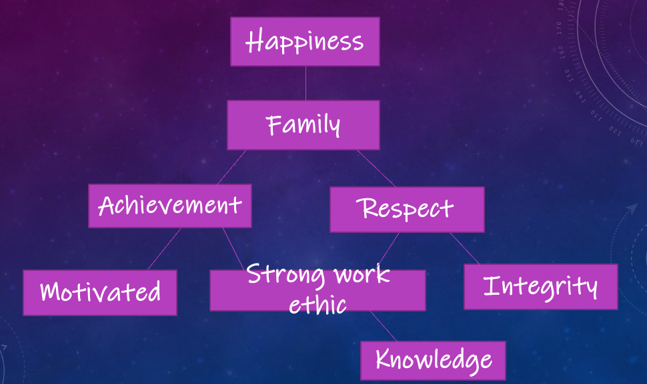
Laura Tejeda

Slide 28
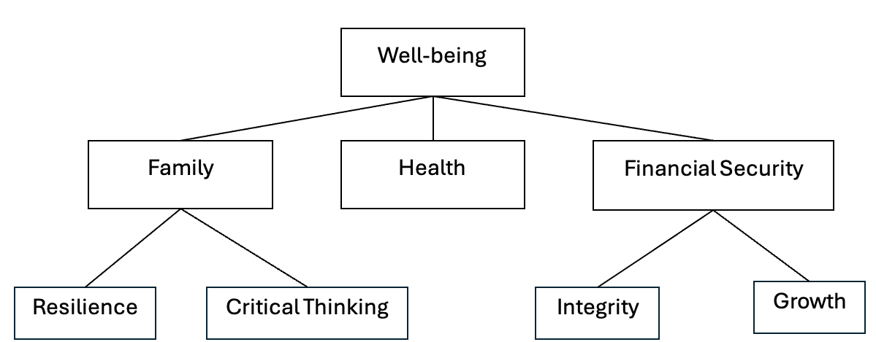
Qianyan Liu

Slide 29
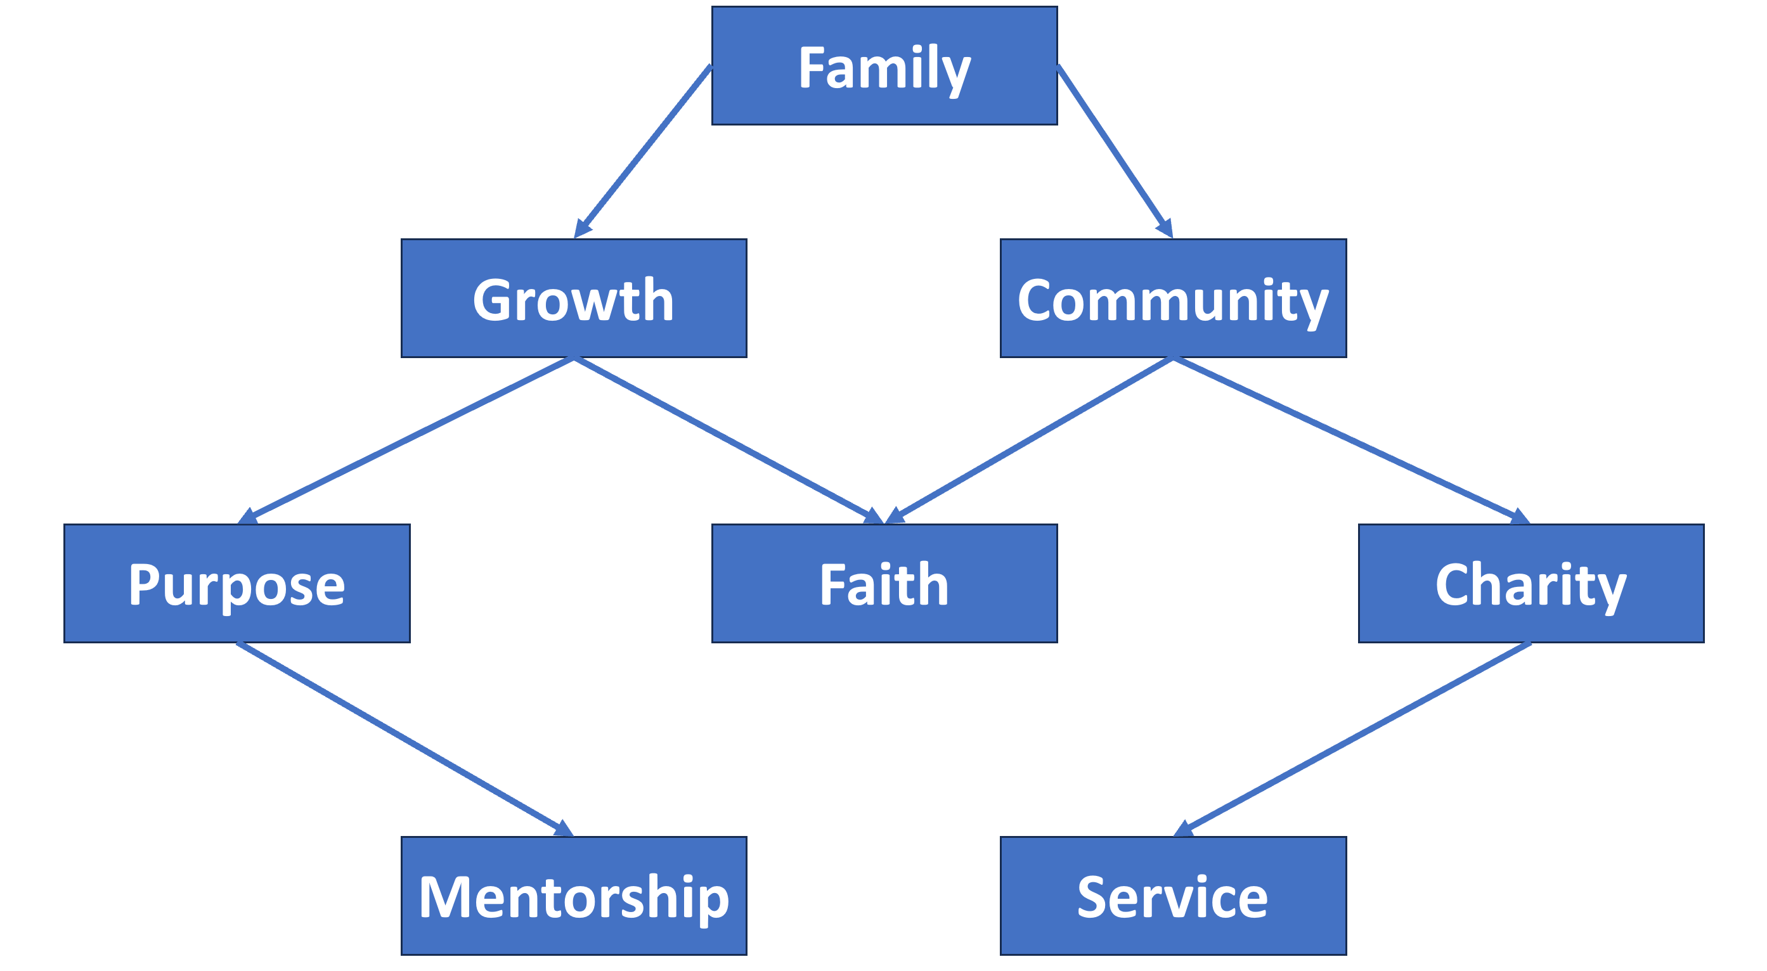
Michael Morano

Slide 30
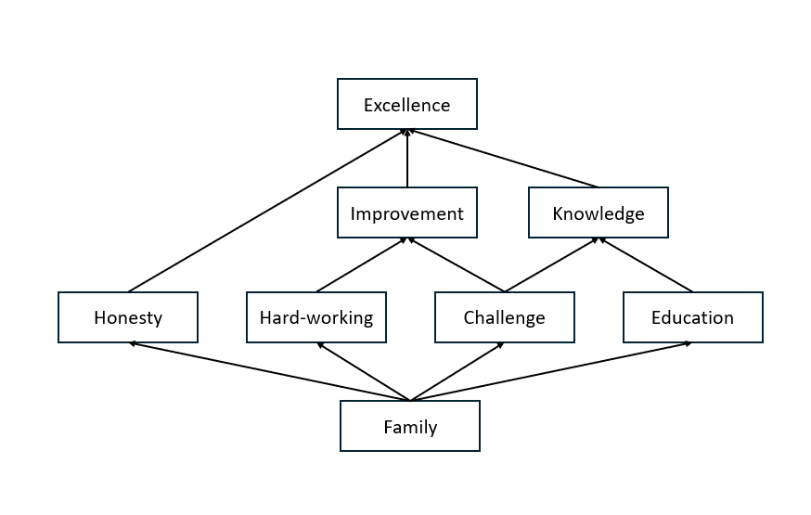
Dirk Noack

Slide 31
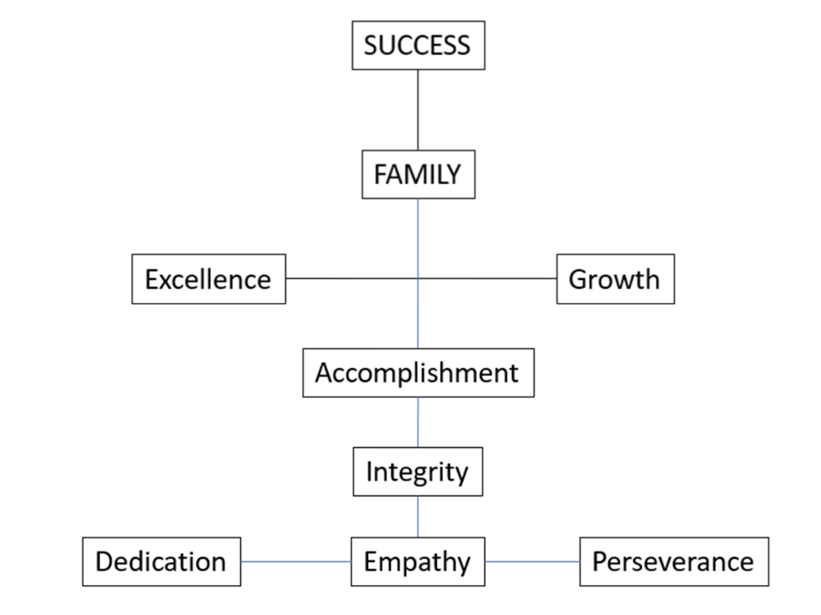
Francesco Mirabelli

Slide 32
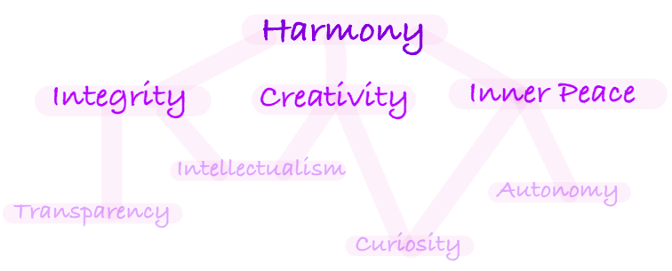
Claire Luckey

Slide 33
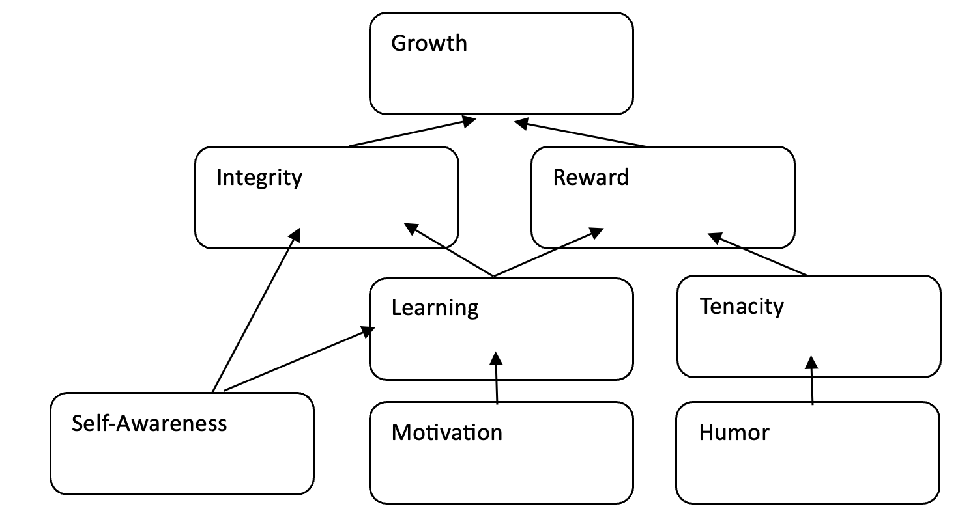
Steve Qiu

Slide 34
Paul Palen

Slide 35
Zach Owens

Slide 36
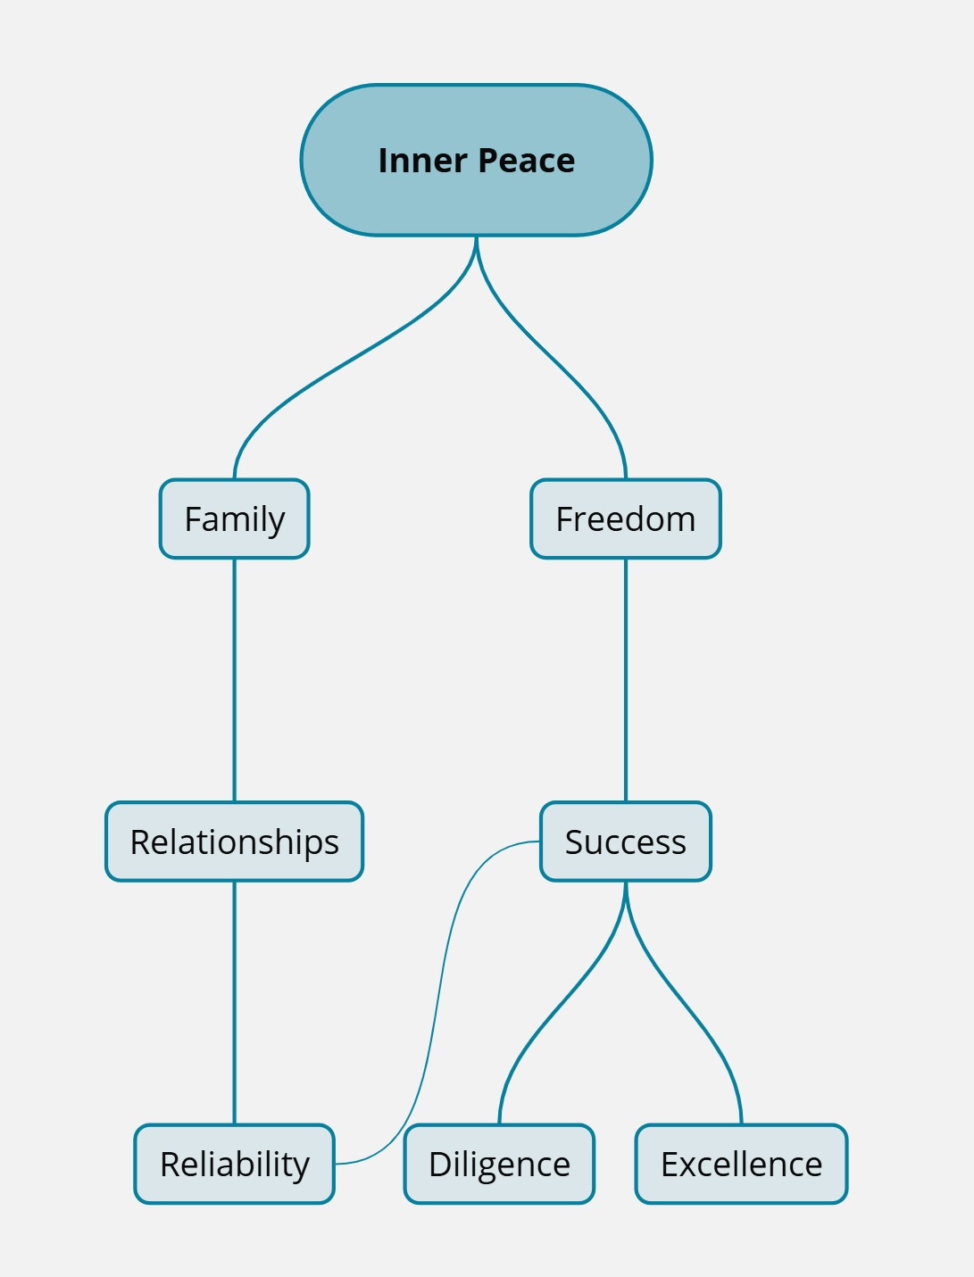
Liam O’Sullivan

Slide 37
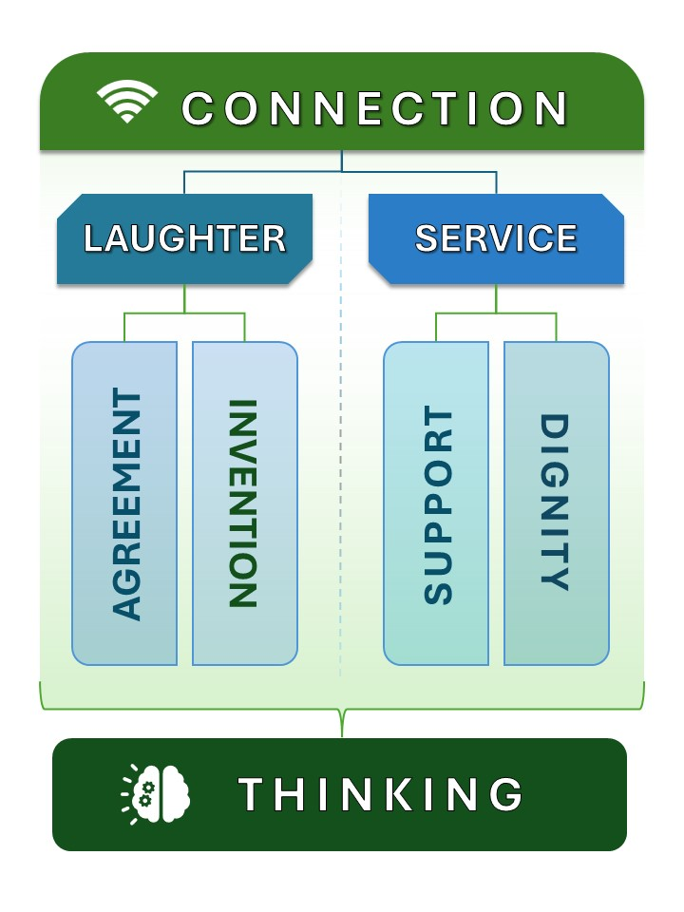
Makho Nsibandze
Notes:
Thinking goes above

Slide 38
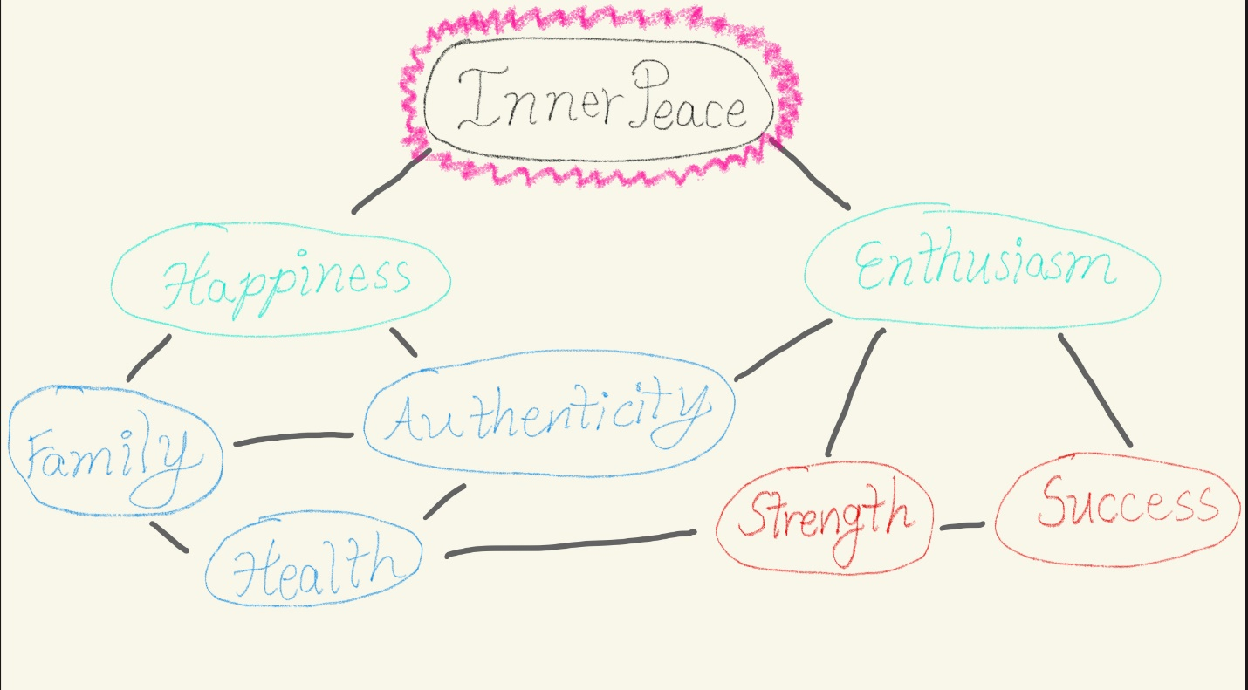
Holly Wady

Slide 39
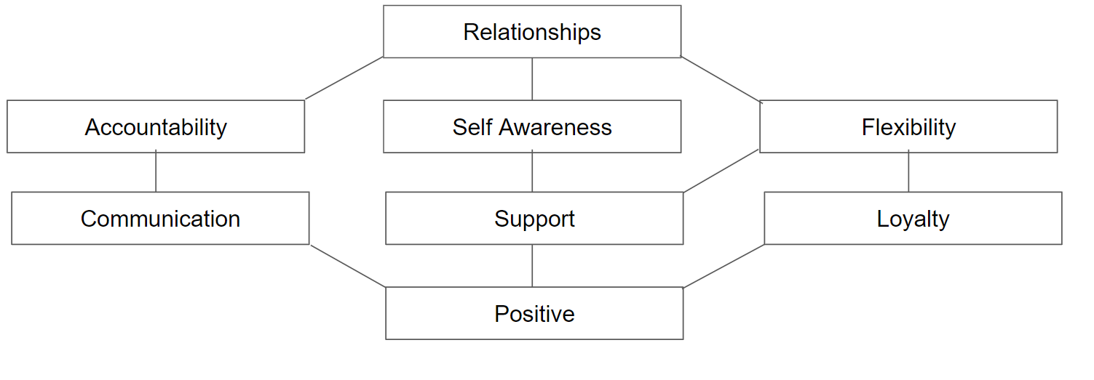
Dorel Tamam

Slide 40
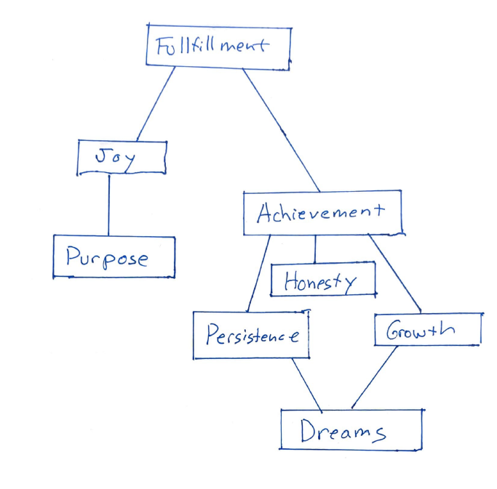
Cameron M. Stacy

Slide 41
Jennifer Toth

Slide 42
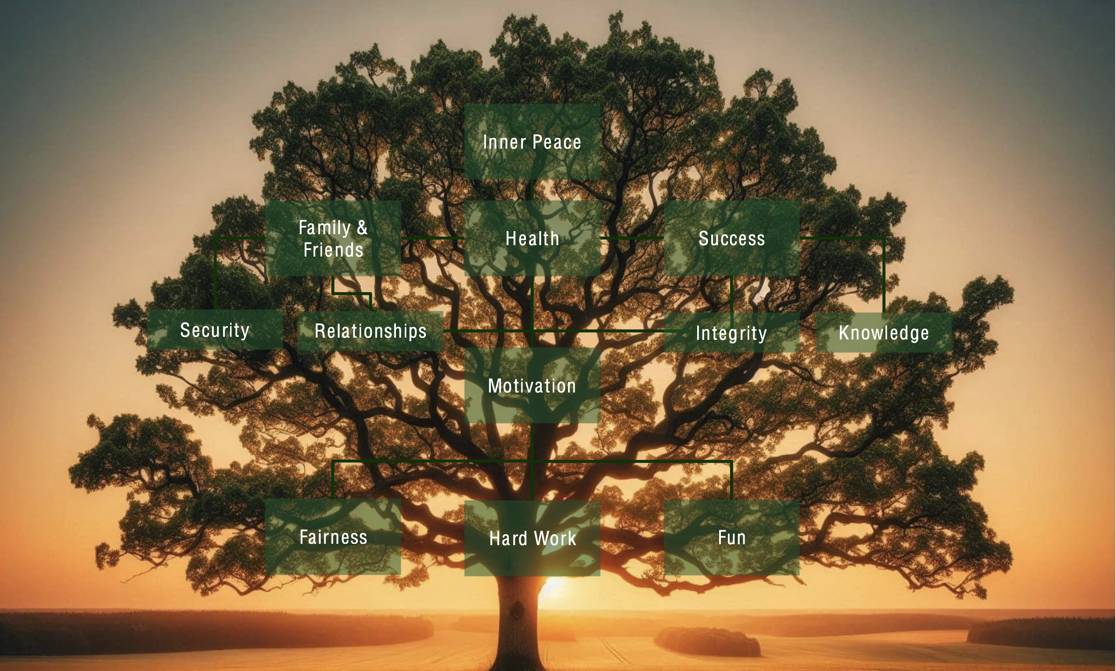
Christian Stracke

Slide 43
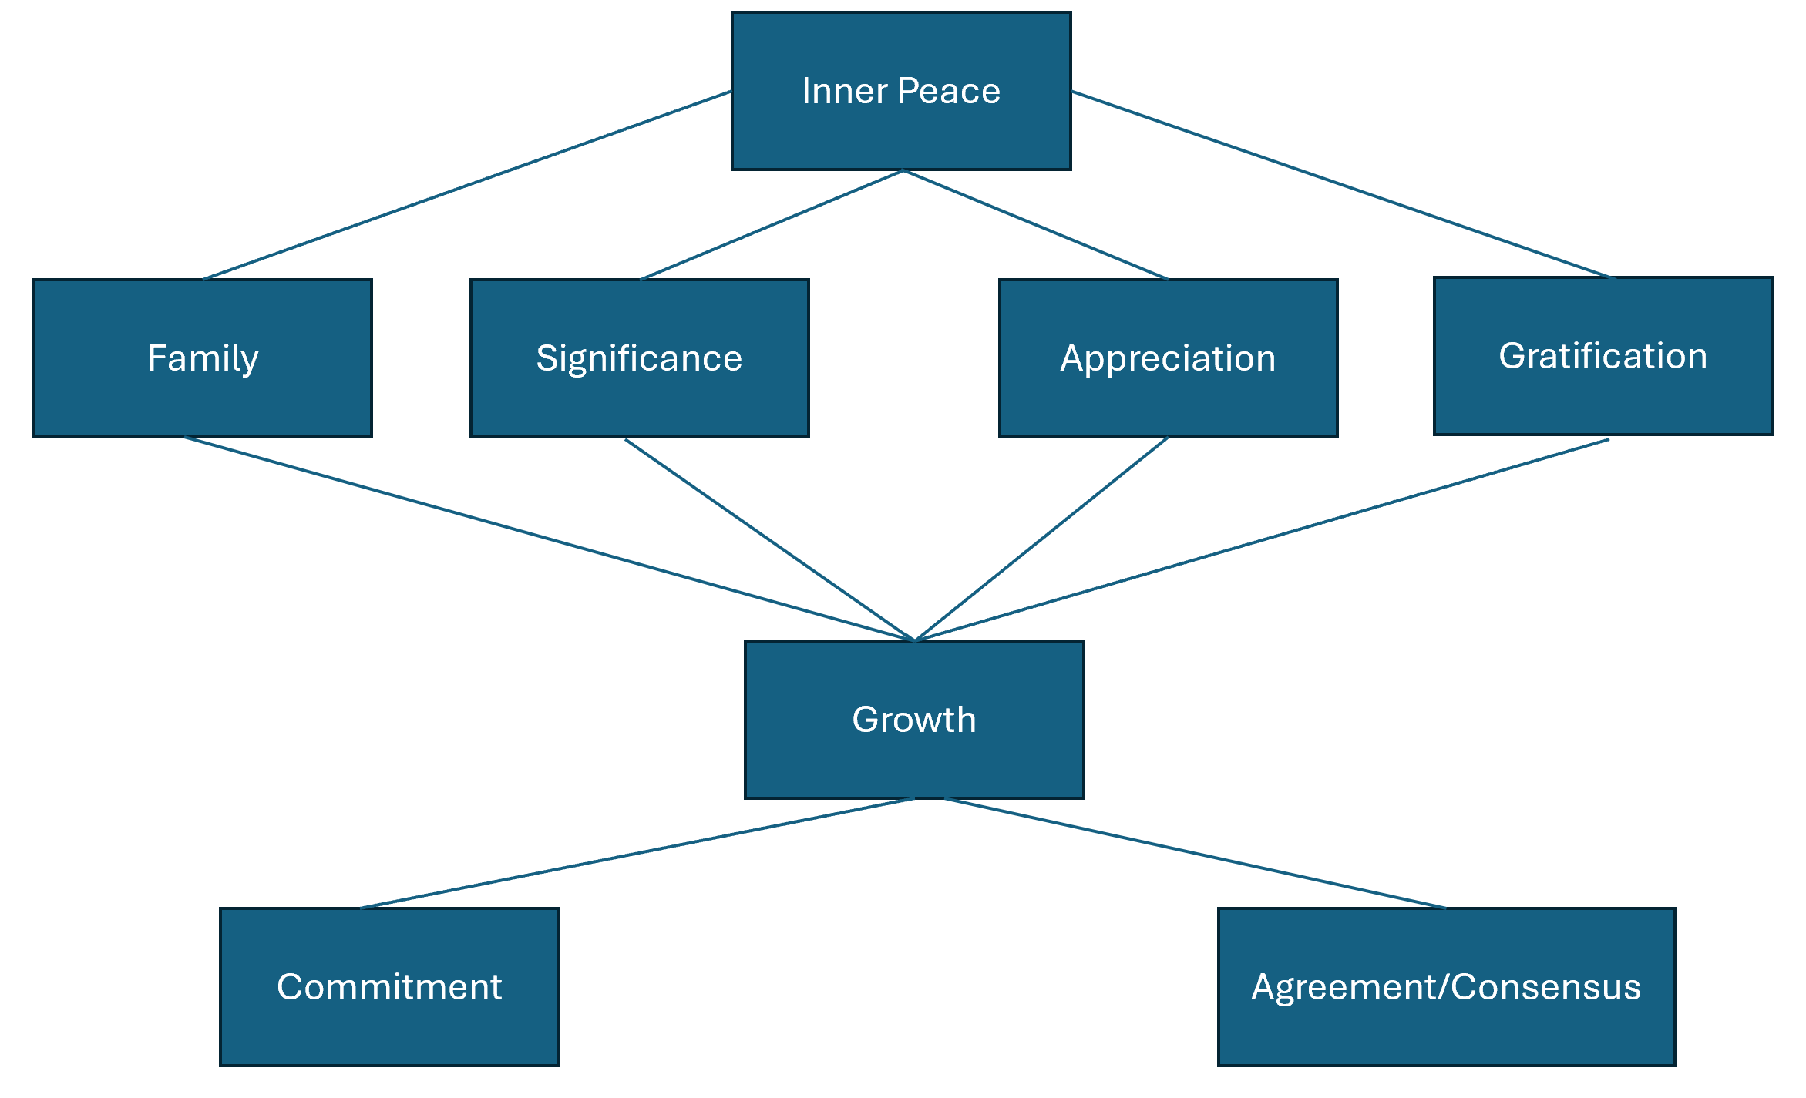
Jake Torrenzano

Slide 44
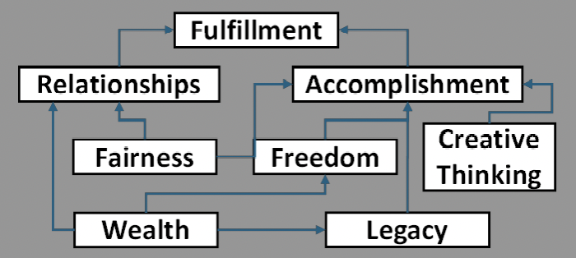
Siddharth Ganesan

Slide 45
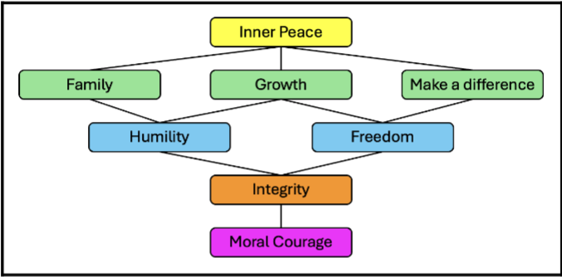
Grishka Bonlong

Slide 46
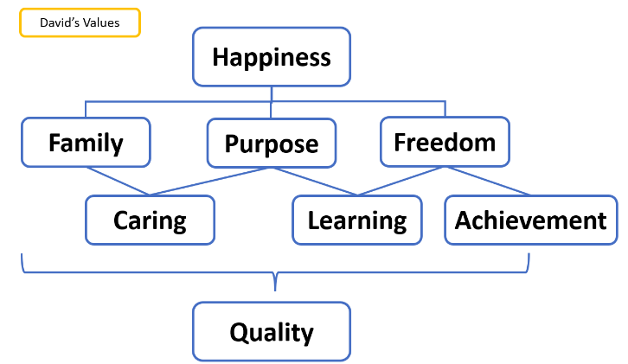
David Burns

Slide 47
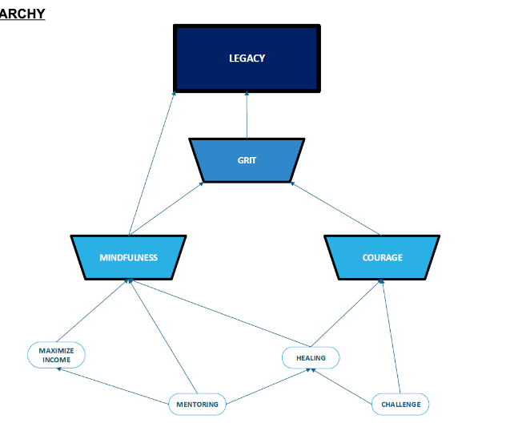
Richard (Rich) Cadena

Slide 48
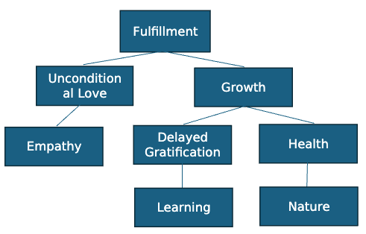
Henry Cassriel

Slide 49
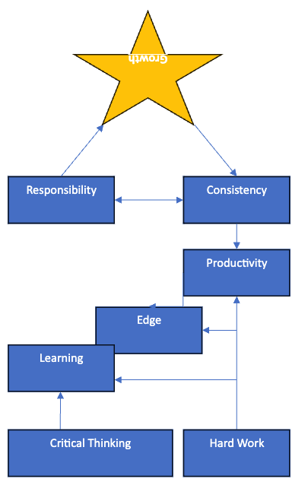
Yuri Dagan

Slide 50
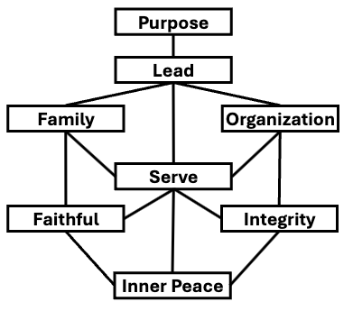
Kingsley Ehie

Slide 51
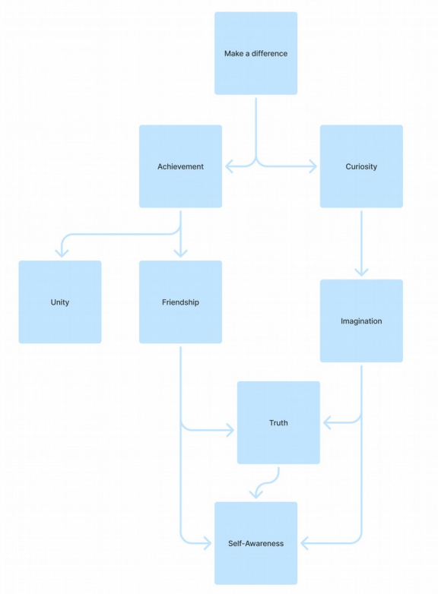
William Essilfie

Slide 52
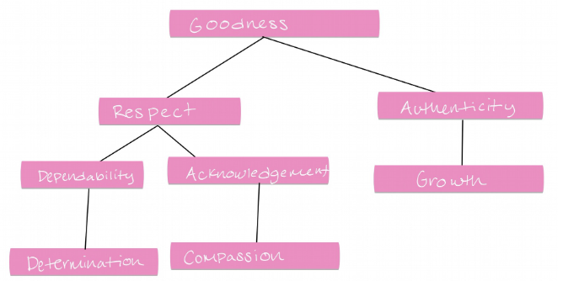
Emily Koh

Slide 53
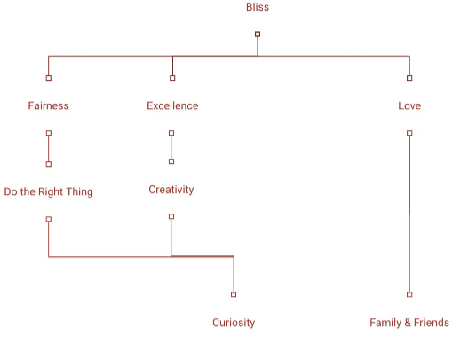
Deborah Oshuntola

Slide 54
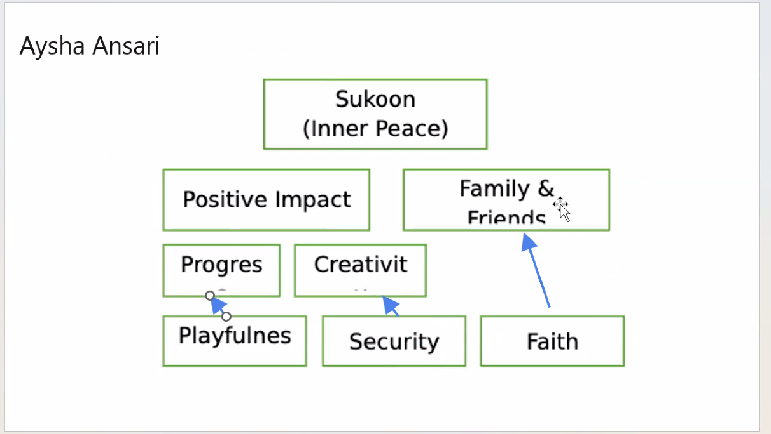
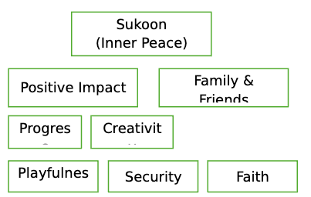
Aysha Ansari

Slide 55
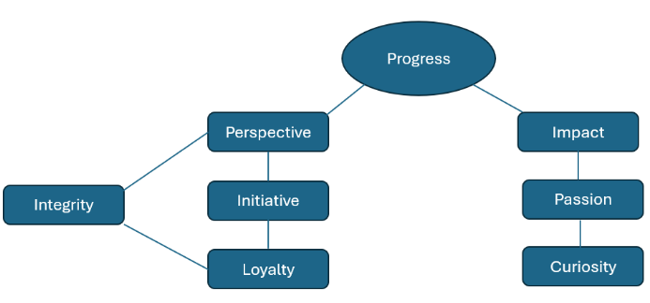
Ilan Goldberg

Slide 56
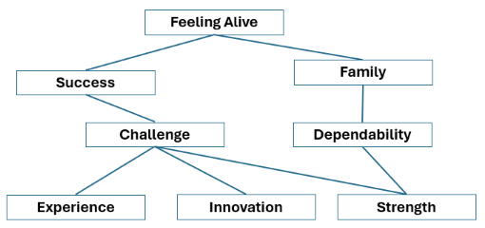
Kyle Hamm

